Slide 1

Quantum Computing and How it affects information security
Jerry Olds

Slide 2
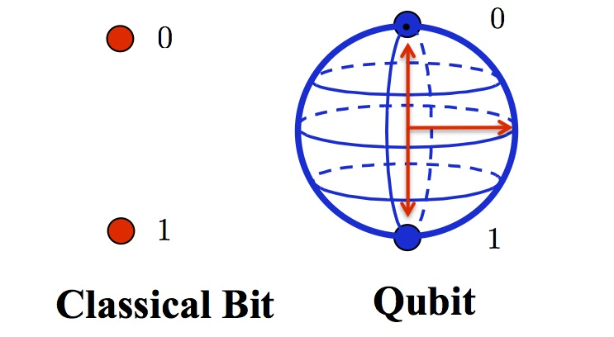
How A Quantum Computer Works
Quantum computers use Quantum bits (Qubits) to preform operations. A Qubit can be equal to 0, 1 or a linear combination of both due to a phenomenon known as superposition.
This allows quantum computers to use significantly less bits to preform operations than a classical (binary) computer.
For example, it takes 8 bits to represent a number from 0-255 in a classical computer. You can represent every number in that range at the same time with 8 qubits. It takes only a couple hundred qubits to represent the number of atoms in the universe (10⁸²).

Slide 3
How much faster is a quantum computer than a classical computer?
Quantum computers are not going to replace classical computers. Classical computers are much better at preforming daily tasks like surfing the web or sending emails. Quantum computers are only good at solving complex mathematical problems.
Quantum supremacy: The goal of demonstrating that a quantum device can solve a problem that a classical computer cannot.
Google claimed quantum supremacy on October 23, 2019 when their 54-qubit processor named Sycamore solved a problem in 200 seconds that would’ve taken a classical computer 10,000 years. Sycamore calculated the likelihood of randomly generated bit strings (what is the likelihood of the string 100110 being randomly generated?).
IBM claimed that its supercomputer could preform the same task Sycamore did in 2.5 days.

Slide 4
What does this mean for information security?
Passwords that would take millions of years to brute force can be cracked by a quantum computer in days.
Encrypted data can be quickly decrypted by quantum computers.
New encryption techniques can be created using quantum computers to prevent unwanted decryption of important data.

Slide 5

How far off is quantum computing?
Current quantum computers only work in very controlled environments. Outside disturbances such as noise, airflow, and temperature change will disturb qubit operation.
Major corporations such as Google, IBM, and Amazon are currently the only owners of quantum devices.
It will be many years until quantum computing is more prevalent. They are not a threat to our security yet.

Slide 6
References
https://www.quantum-inspire.com/kbase/what-is-a-qubit/
https://www.newscientist.com/question/what-is-a-quantum-computer/
https://www.npr.org/2019/10/23/772710977/google-claims-to-achieve-quantum-supremacy-ibm-pushes-back
https://www.technologyreview.com/s/613596/how-a-quantum-computer-could-break-2048-bit-rsa-encryption-in-8-hours/

